Slide 1


Mark Camball
Blockchain-Enabled Prediction Markets

Slide 2
1
Prediction Markets
To Make a Market
Blockchain
Payout rules
Liquidity
Oracles
Pitfalls
2
3
4
5
6
7
Prediction markets
To Make a Market
Blockchain
Payout Rules
Liquidity
Oracles
Pitfalls

Slide 3
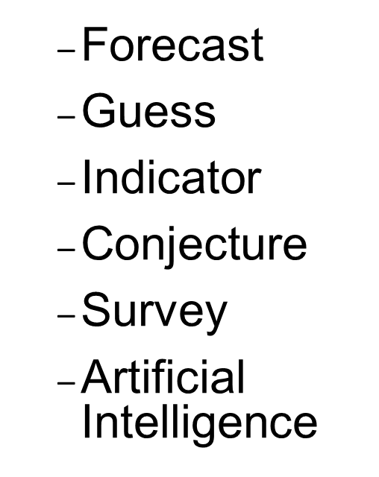
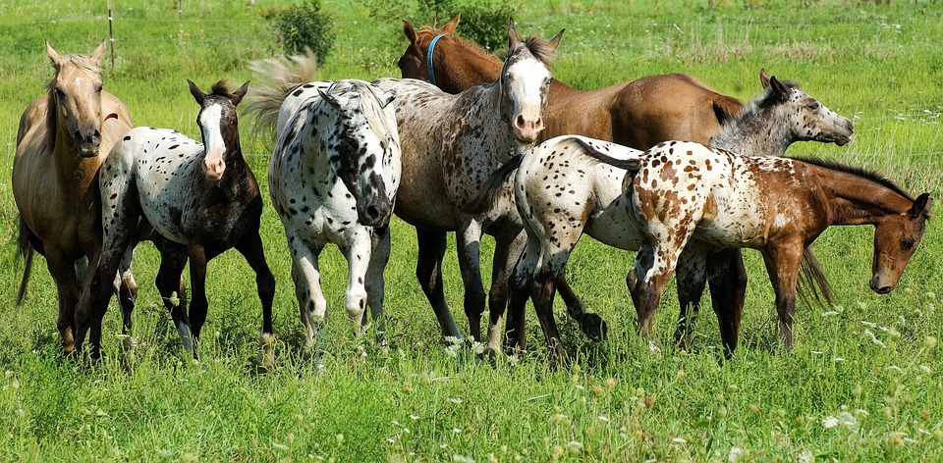
Prediction
Prediction markets
To Make a Market
Blockchain
Payout Rules
Liquidity
Oracles
Pitfalls

Slide 4
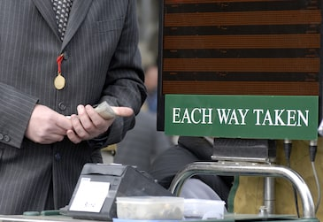
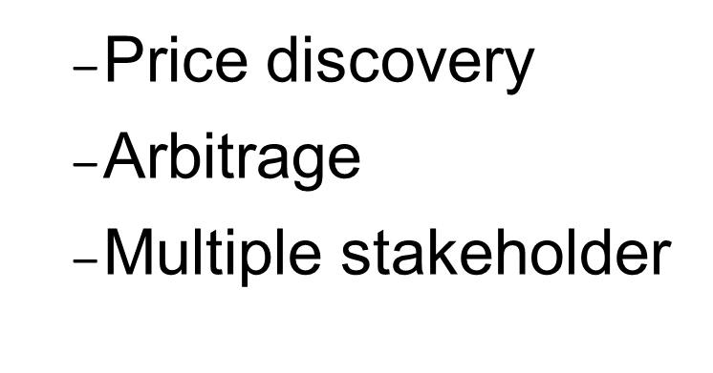
Market
Prediction markets
To Make a Market
Blockchain
Payout Rules
Liquidity
Oracles
Pitfalls

Slide 5
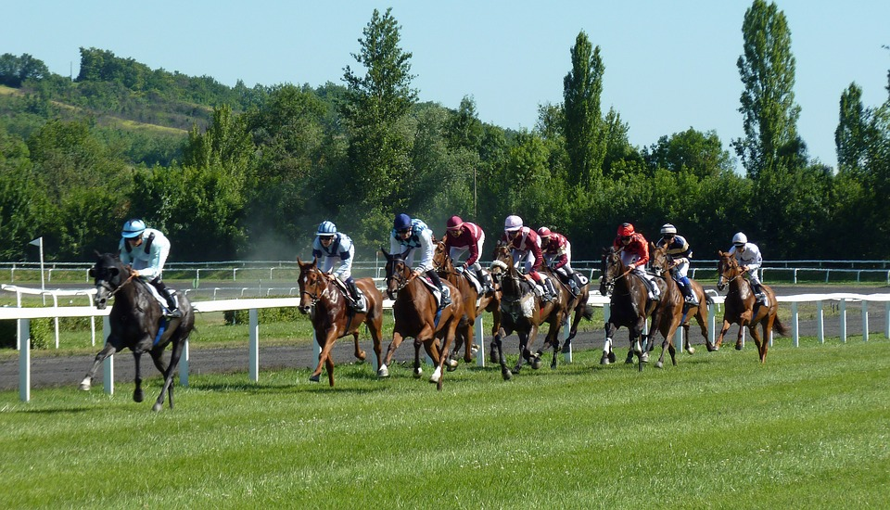
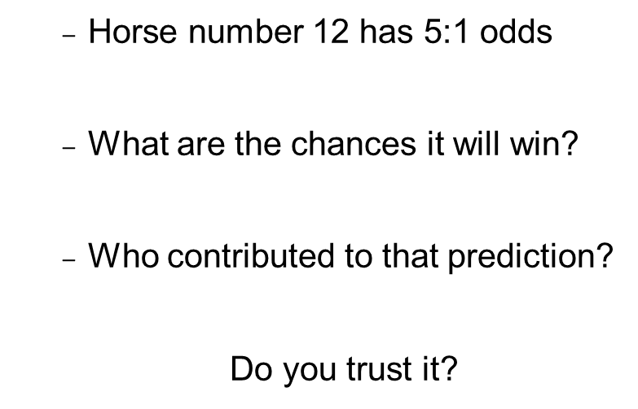
Is this a prediction market?
Prediction markets
To Make a Market
Blockchain
Payout Rules
Liquidity
Oracles
Pitfalls

Slide 6
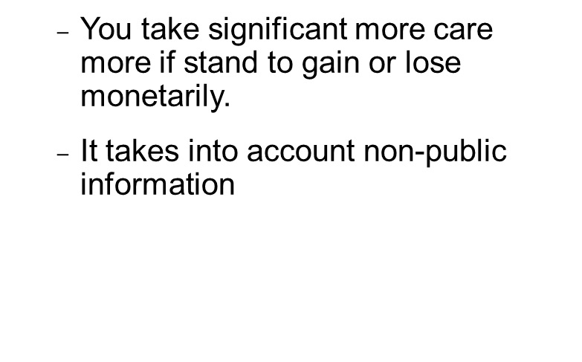
Why does it work?
“wisdom of the crowd”
Prediction markets
To Make a Market
Blockchain
Payout Rules
Liquidity
Oracles
Pitfalls

Slide 7
Why does it work?
“wisdom of the crowd”
Prediction markets
To Make a Market
Blockchain
Payout Rules
Liquidity
Oracles
Pitfalls

Slide 8
To Make a Prediction Market
(You must first create the “tickets/tokens”)
Set payout rules
The person who bet on the winning horse takes all
The winning horse takes 60%, second place bets get 30% and third place gets 10%
Other..
Sell “All Tickets”
Buy one of every ticket for $100
Determine winner
And the winner is….
Payout winners
$
Prediction markets
To Make a Market
Blockchain
Payout Rules
Liquidity
Oracles
Pitfalls

Slide 9
A demo Prediction Market
“What is the word on the next slide?”
Set payout rules
If the word on my page is
“Defense” the pink ticket is worth $0.01, otherwise the yellow ticket is worth $0.01
Sell “All Tickets”
For $0.01 you can buy one pink tickets and one yellow ticket
Determine winner
I’ll tell you the word in five minutes
Payout winners
I’ll give you the agree upon value of the pink and yellow tickets in five minutes
“Defense”
Not “Defense”
Prediction markets
To Make a Market
Blockchain
Payout Rules
Liquidity
Oracles
Pitfalls

Slide 10
Defence
Prediction markets
To Make a Market
Blockchain
Payout Rules
Liquidity
Oracles
Pitfalls

Slide 11
To Make a Prediction Market usable
(There must be liquidity for tokens)
Set payout rules
The person who bet on the winning horse takes all
The winning horse takes 60%, second place bets get 30% and third place gets 10%
Other..
Sell “All Tickets”
Buy one of every ticket for $100
Buy/Sell Tickets
Betting on horse#12 costs $5
Betting on horse#5 costs $12
Determine winner
And the winner is….
Payout winners
$
Prediction markets
To Make a Market
Blockchain
Payout Rules
Liquidity
Oracles
Pitfalls

Slide 12
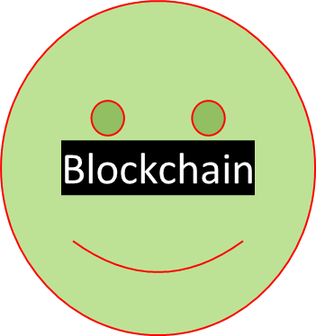
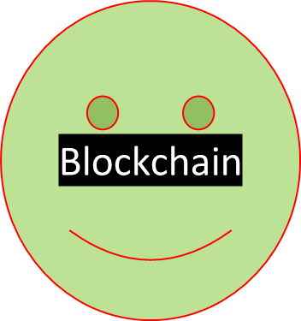
That’s not what we agreed.
What if I don’t want to pay what we agreed?
Set payout rules
The person who bet on the winning horse takes all
The winning horse takes 60%, second place bets get 30% and third place gets 10%
Other..
Sell “All Tickets”
Buy one of every ticket for $100
Buy/Sell Tickets
Betting on horse#12 costs $5
Betting on horse#5 costs $12
Determine winner
And the winner is….
Payout winners
$
Prediction markets
To Make a Market
Blockchain
Payout Rules
Liquidity
Oracles
Pitfalls

Slide 13

How many markets…?
What about counterfeit tickets?
Set payout rules
The person who bet on the winning horse takes all
The winning horse takes 60%, second place bets get 30% and third place gets 10%
Other..
Sell “All Tickets”
Buy one of every ticket for $100
Buy/Sell Tickets
Betting on horse#12 costs $5
Betting on horse#5 costs $12
Determine winner
And the winner is….
Payout winners
$
Prediction markets
To Make a Market
Blockchain
Payout Rules
Liquidity
Oracles
Pitfalls

Slide 14
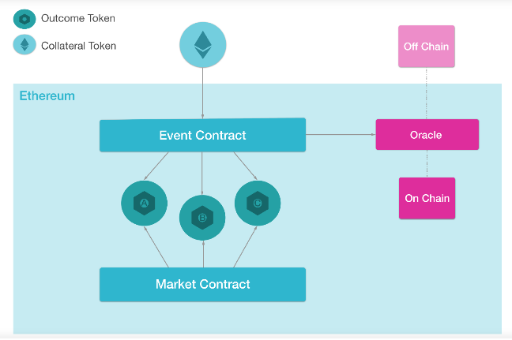



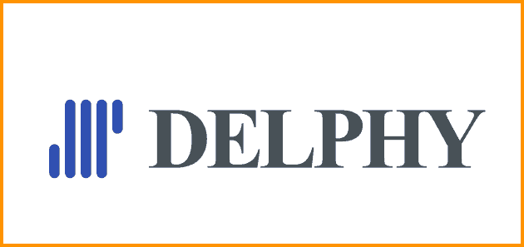
Mature blockchain prediction market platforms
https://blog.gnosis.pm/getting-to-the-core-4db11a31c35f
Prediction markets
To Make a Market
Blockchain
Payout Rules
Liquidity
Oracles
Pitfalls

Slide 15
Payouts can be pre-arranged in various ways
Categorical
Scalar
Will trump win the 2020 election?
What will the price of one common Tesla share be on Jan 1, 2019?
Who will win the sports event?
1) Yes 2) No
1) $0 2) $1-$100
3) $101-200$
4) $201-$300 5) $301+
1) Team A
2) Team B
3) Team C
NA
Lower Bound->$0
Upper Bound->$500
NA
Prediction markets
To Make a Market
Blockchain
Payout Rules
Liquidity
Oracles
Pitfalls

Slide 16
Predictions of various payout types
Categorical => Predicted Likelihood
Scalar => Predicted Value
Price of outcome token
____________________
Price of collateral token
Outcome Token 0 Outstanding +
Market Maker Funding
Predicted Value
Outcome Token 1 Outstanding +
Market Maker Funding
Lower Bound
Upper Bound
Prediction markets
To Make a Market
Blockchain
Payout Rules
Liquidity
Oracles
Pitfalls

Slide 17
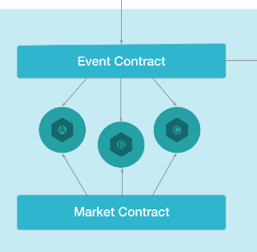
Every bet needs a counterparty
Logarithmic Market Scoring Rule
C = b * ln(e^{q1/b}+e^{q2/b})
Change the price
Vs
Buy and sell shares
Prediction markets
To Make a Market
Blockchain
Payout Rules
Liquidity
Oracles
Pitfalls

Slide 18
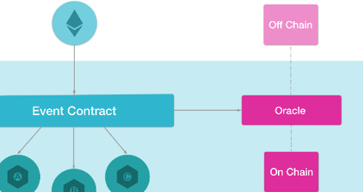
The contract needs to know the settled outcome
On-Chain Oracles
Centralized Oracles
Decentralized Oracles
Prediction markets
To Make a Market
Blockchain
Payout Rules
Liquidity
Oracles
Pitfalls

Slide 19
Other considerations
Illegal bets
Technological complexity
Small markets to make big decisions
Funds are locked up
Prediction markets
To Make a Market
Blockchain
Payout Rules
Liquidity
Oracles
Pitfalls

Slide 20
Discussion
“You’re incentivizing people to really search for the truth.”
mcamball@metameshgroup.com

